Slide 1
Midterm Presentation
Stochastic Resonance and Negative Inductance in Square-loop FM Core
Manikantan R S
(122101046)
Kevin R Jacob
(122101018)
Under the guidance of
Dr. Arvind Ajoy

Slide 2
Continuation from the previous semester OELP …
Notes:
In the last year oelp we developed the theoretical background on ferromagnetic materials, Landau-Ginzburg theory which explains the phase transition dynamics of Ferromagnetic materials, and explored the possibility of transient Negative inductance in a square-loop FM core. This oelp project is continuation of the work of our senior Priyyanka, who already builds a framework which shows the existence of NI.

Slide 3
Key words
FM – Ferro Magnet
FE – Ferro Electric
NI – Negative Inductance
NC – Negative Capacitance
SR – Stochastic Resonance
VCCS – Voltage controlled Current source
PCB – Printed Circuit Board
SMU – Source Meter Unit

Slide 4
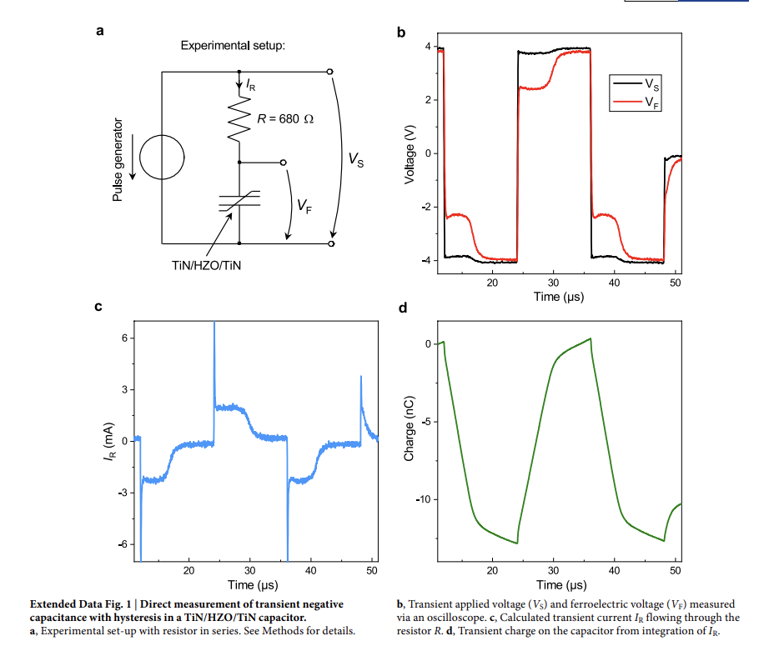
What is Negative Inductance ?
In recent years, negative capacitance has risen in popularity with its effect manifesting in ferroelectric materials
This discovery holds promise for paving the way to create more energy-efficient electronics.
This prompts the question of existence of a dual, which is negative inductance (NI)
Source link : https://doi.org/10.1038/s41586-018-0854-z

Slide 5
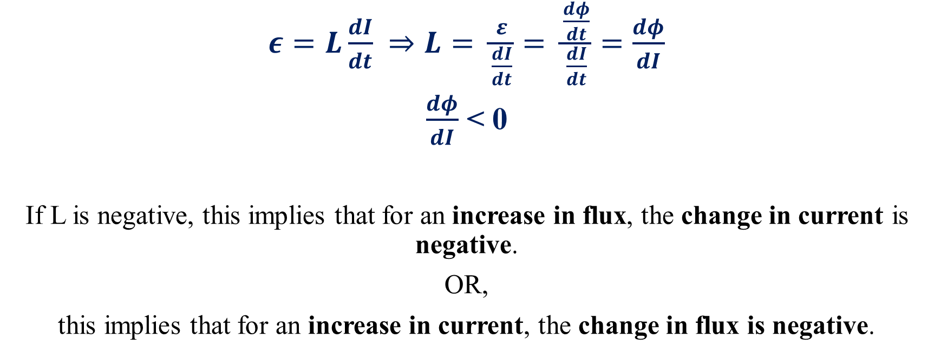
What is Negative Inductance ?
$ε=L\frac{dI}{dt}$ $⇒L= \frac{ε}{\frac{dI}{dt}}= \frac{\frac{dφ}{dt}}{\frac{dI}{dt}}=\frac{dφ}{dI}$
$\frac{dφ}{dI}$ < 0
If L is negative, this implies that for an increase in flux, the change in current is negative.
OR,
this implies that for an increase in current, the change in flux is negative.

Slide 6
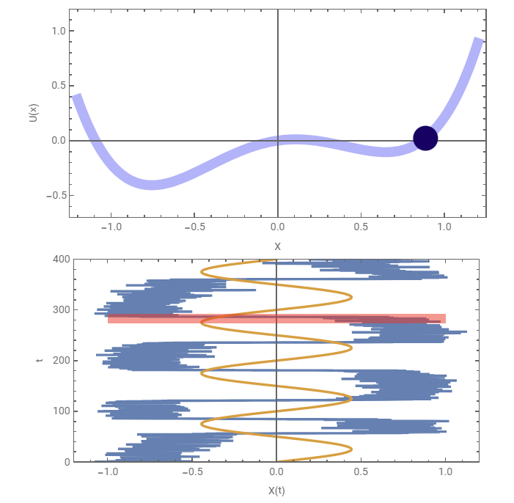
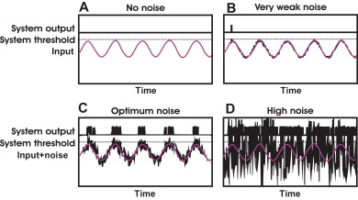
What is Stochastic Resonance ?
Observed in Subthreshold systems and Double well systems
Image source : https://www.researchgate.net/publication/245537925_Modelling_Non-Invasive_Brain_Stimulation_in_Cognitive_Neuroscience/figures?lo=1
Image source :
https://demonstrations.wolfram.com/StochasticResonance/
Notes:
Stochastic Resonance (SR) is a counterintuitive phenomenon where adding the right amount of noise to certain systems increases the Signal to Noise Ratio(SNR) at the output. The amount of noise applied is quantified by its variance. In threshold-based systems, the effect of SR is observed because the noise directly helps the sub-threshold signal to cross the system’s threshold at regular intervals, which is reflected in the output as a signal with a frequency component the same as that of the sub-threshold signal. While in double-well potential systems, for a sub-threshold input signal, the system is essentially transparent with minimal signal distortion and almost the same amplitude of the signal.

Slide 7
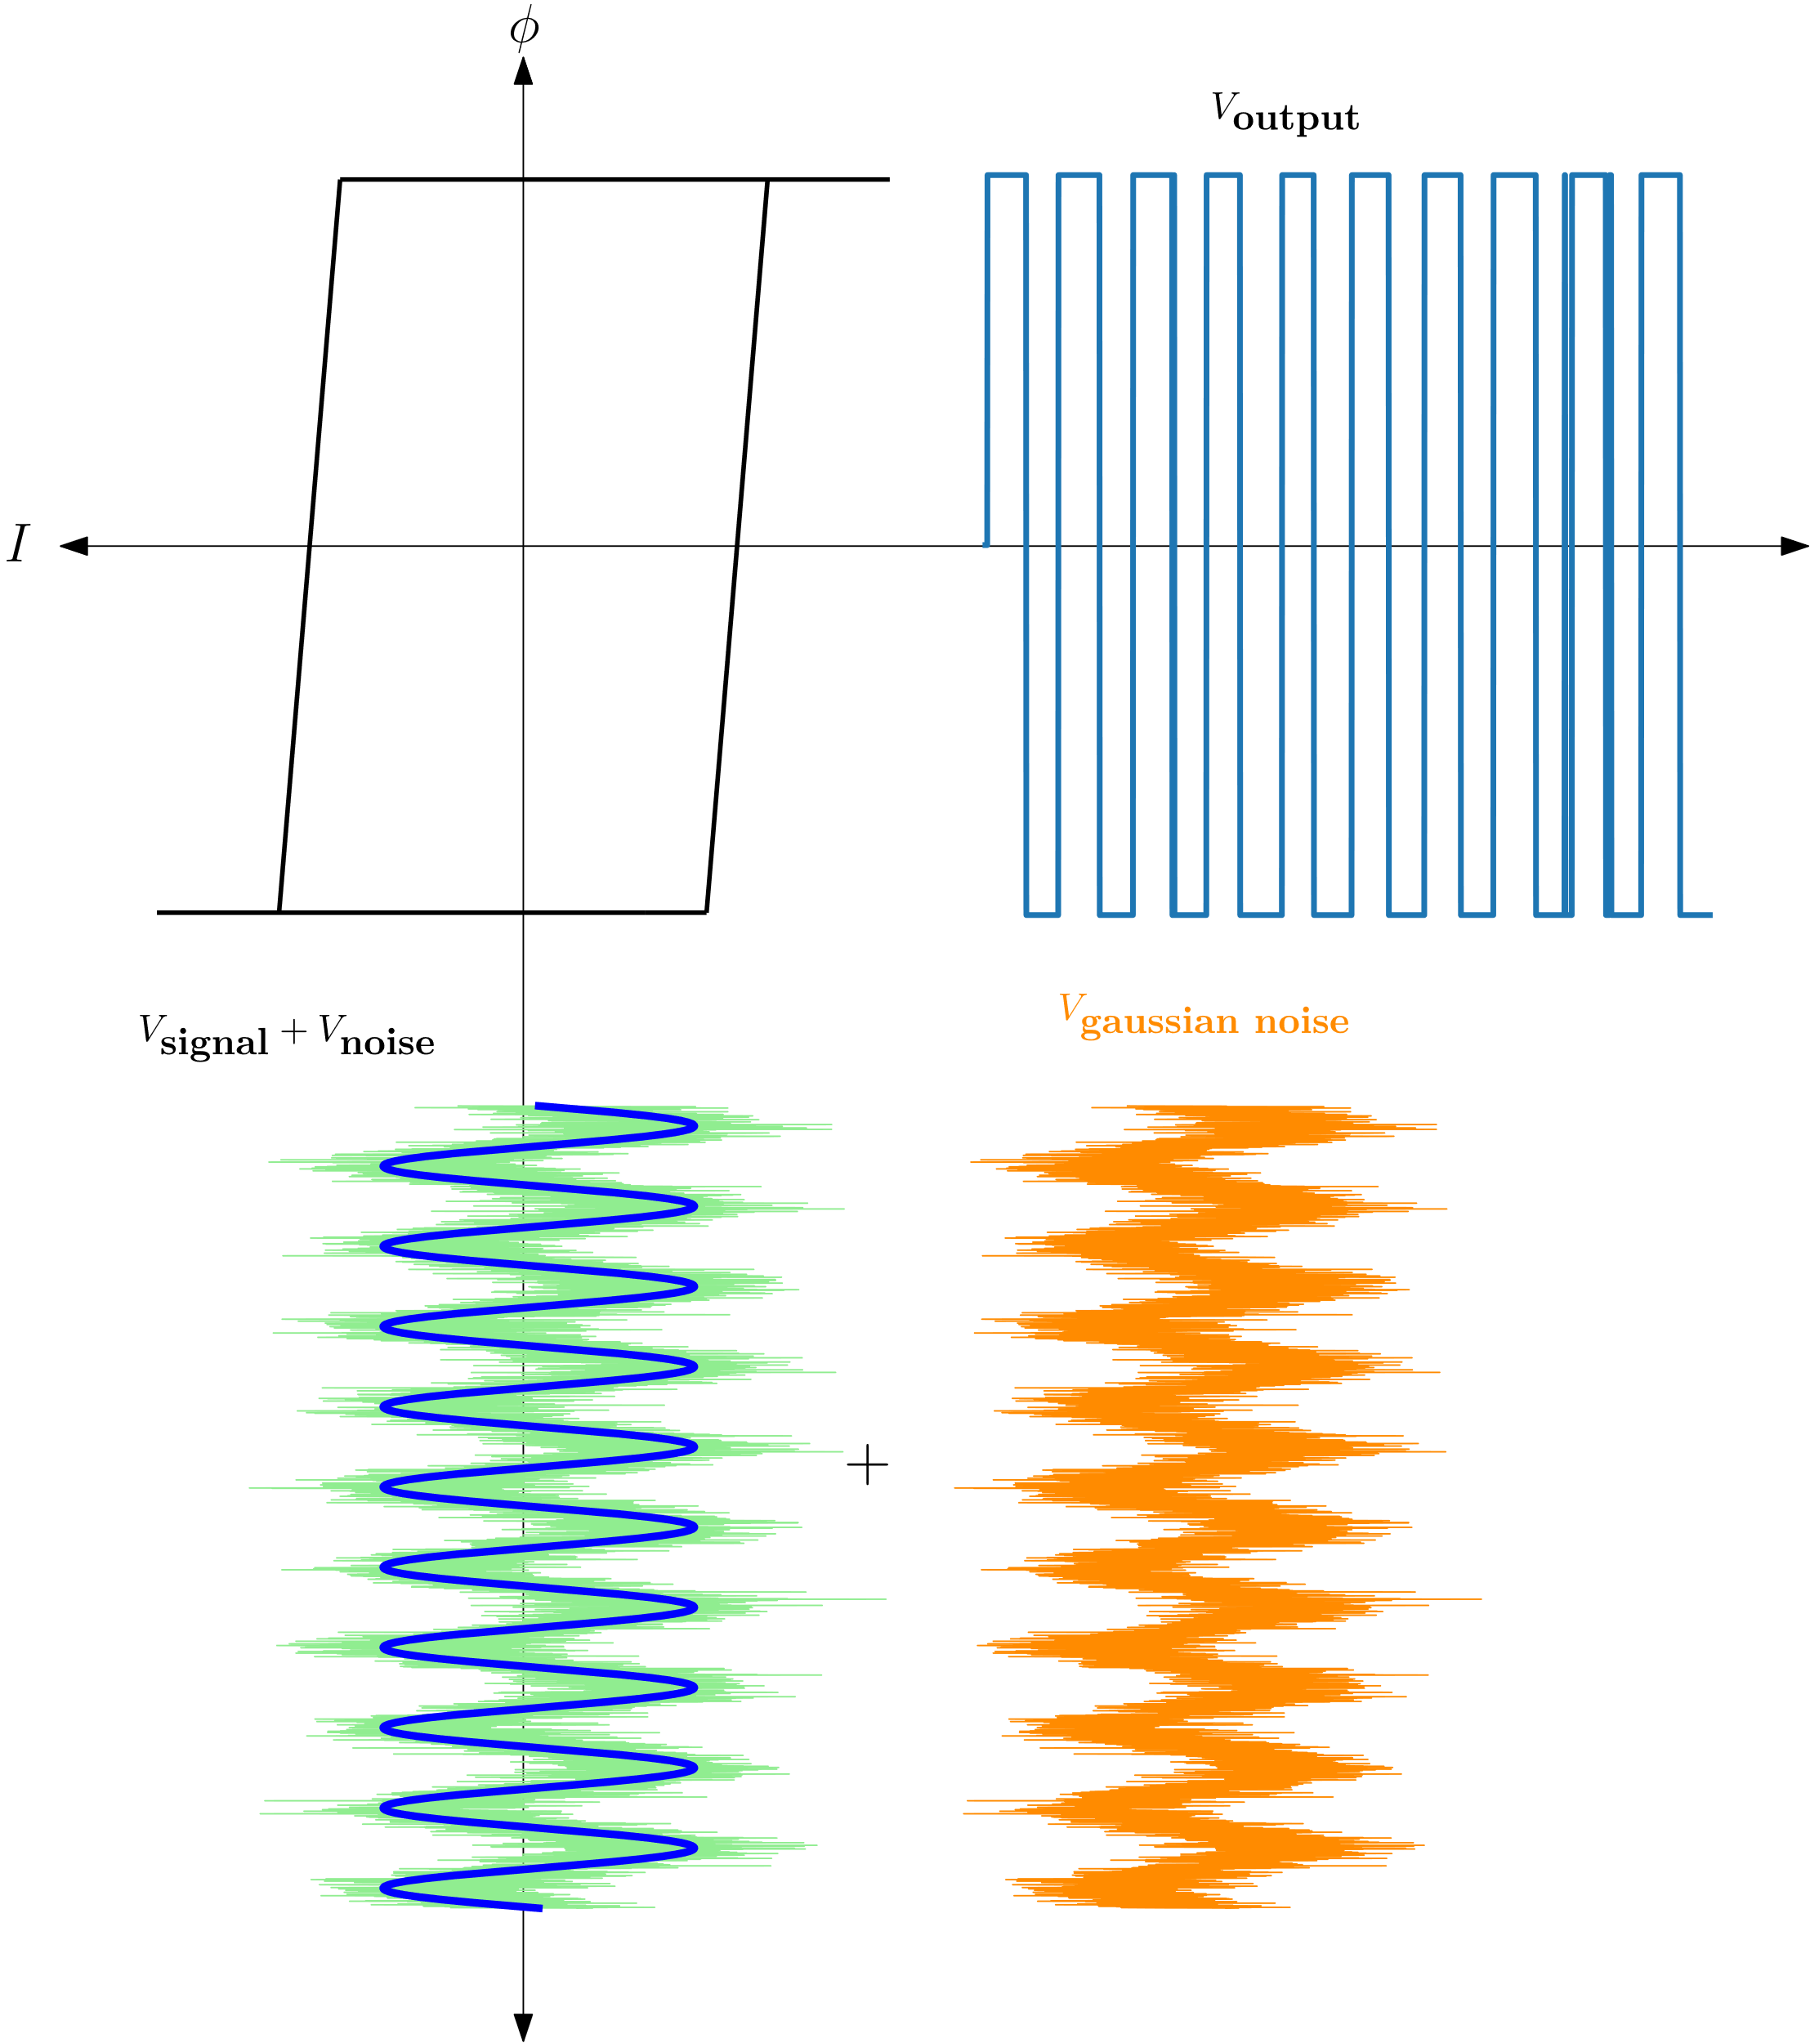
Stochastic Resonance Using FM Inductor
Inductor is a Clipper !
Notes:
White Gaussian Noise
(WGN) applied to the input of a double-well potential system is reflected as a random
walk process in the output, with the variance of its distribution increasing over time. This
means that, given any arbitrary amount of noise, the output will eventually cross the
potential barrier and switch to the other state.

Slide 8
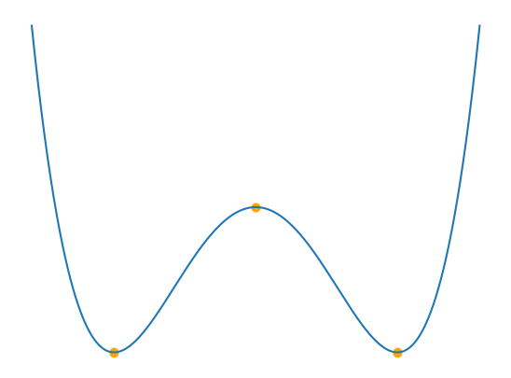
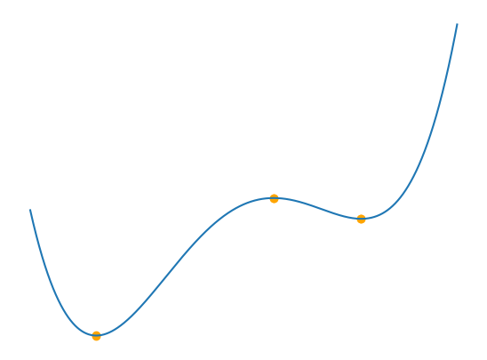
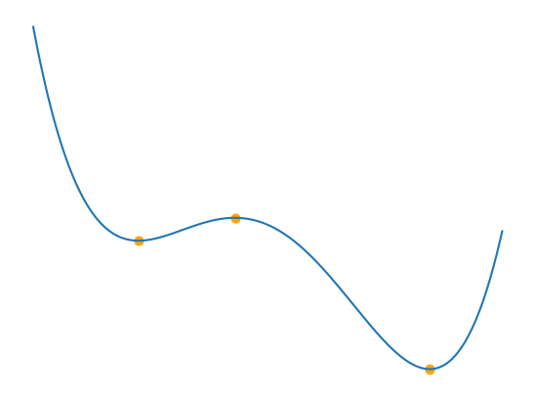
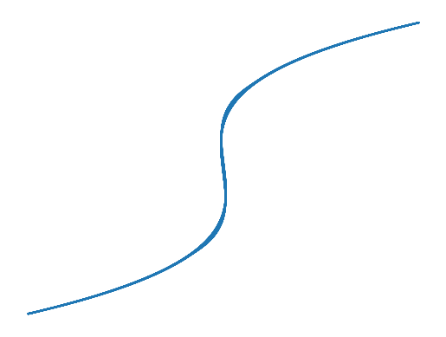
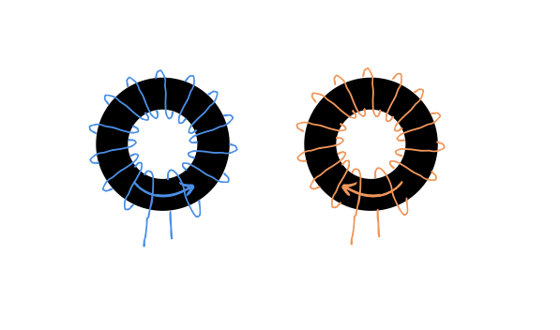
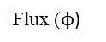
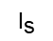
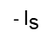
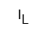
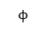
Double well system, Origin of NI and SR
H applied
H applied
$$ϕ$$
Free energy (U)
Free energy (U)
$${\text{I}}_{\text{L}}$$
Flux ($ϕ$)
Flux ($ϕ$)
Applied current to
the inductor
$${\text{I}}_{\text{s}}$$
- ${\text{I}}_{\text{s}}$

Slide 9
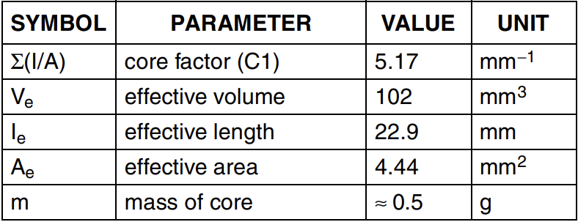
Ferromagnetic Toroid - the “CORE” of this Project
Ferrite toroid (TN/9/6/3) from Ferroxcube

Slide 10
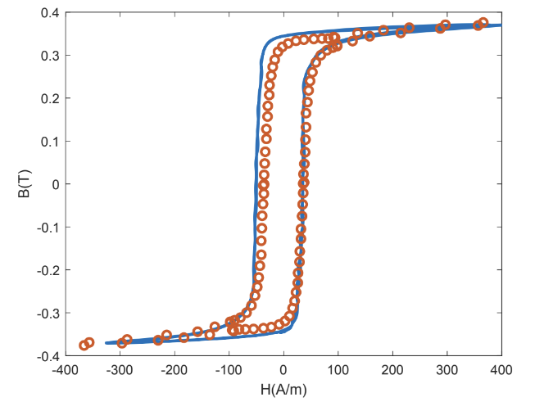
Ferromagnetic Toroid - the “CORE” of this Project
The core has this characteristic square loop hysteresis which is critical for observing NI and SR

Slide 11
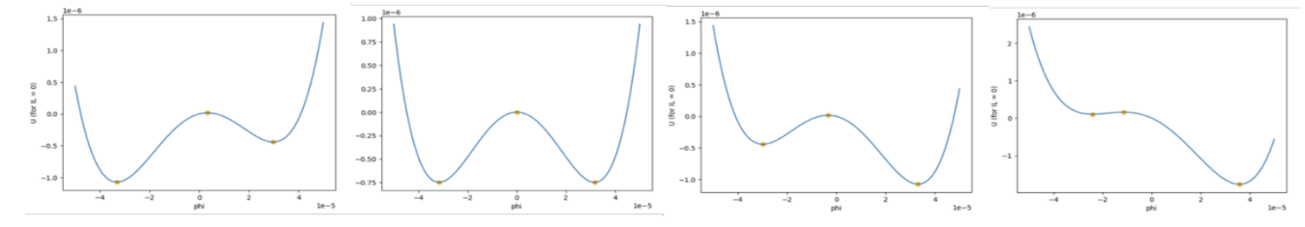
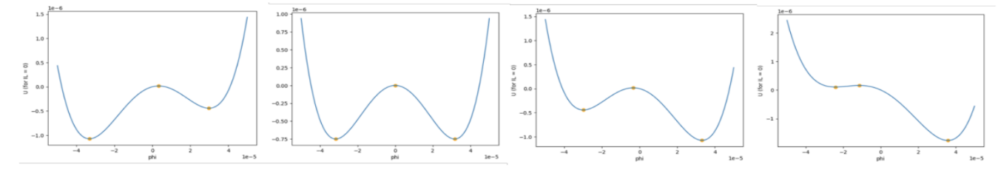

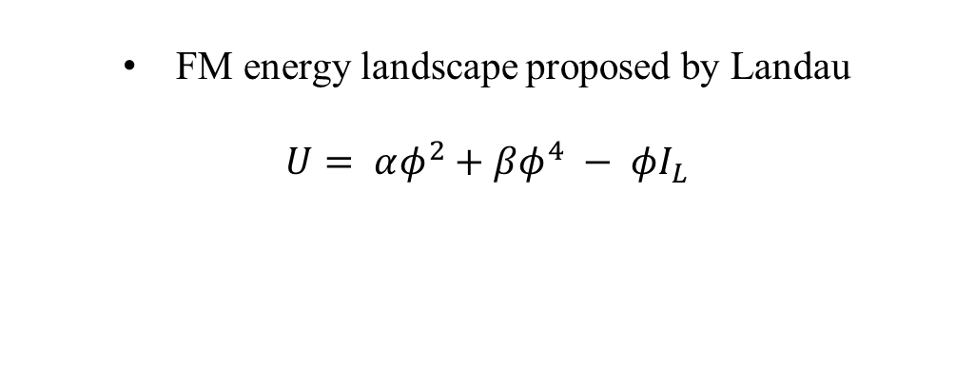
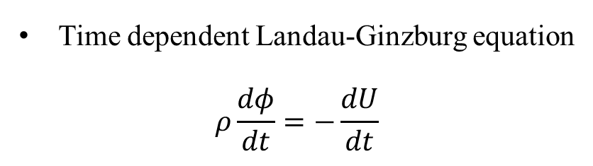
Landau Theory
FM energy landscape proposed by Landau
$$U= αφ^{2}+βφ^{4} − φI_{L}$$
Time dependent Landau-Ginzburg equation
$$ρ\frac{dφ}{dt}=−\frac{dU}{dt}$$
Double well energy landscape of single domain ferromagnet, the change illustrates the polarization switching on applied external magnetic field

Slide 12
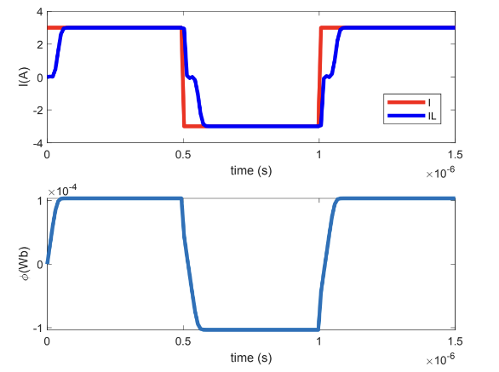
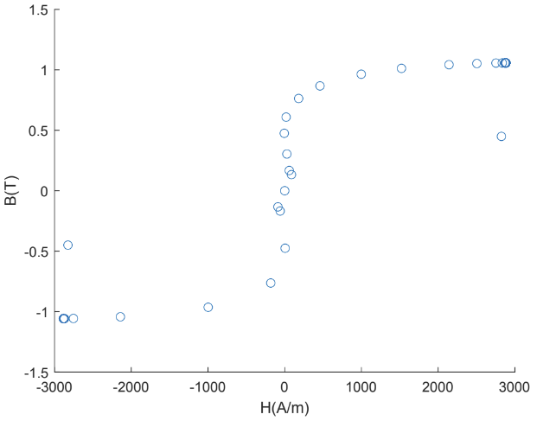
Landau Theory
The B-H loop when plotted will trace the S-curve
The region with negative slope we expected to see
negative inductance
Notes:
To see the transient NI effect clearly, square current waveform is used to excite the inductor. A low resistance is added to slow down the transient period. The results obtained are shown in Figure #. The S curve corresponds to the transient NI switching hysteresis.

Slide 13
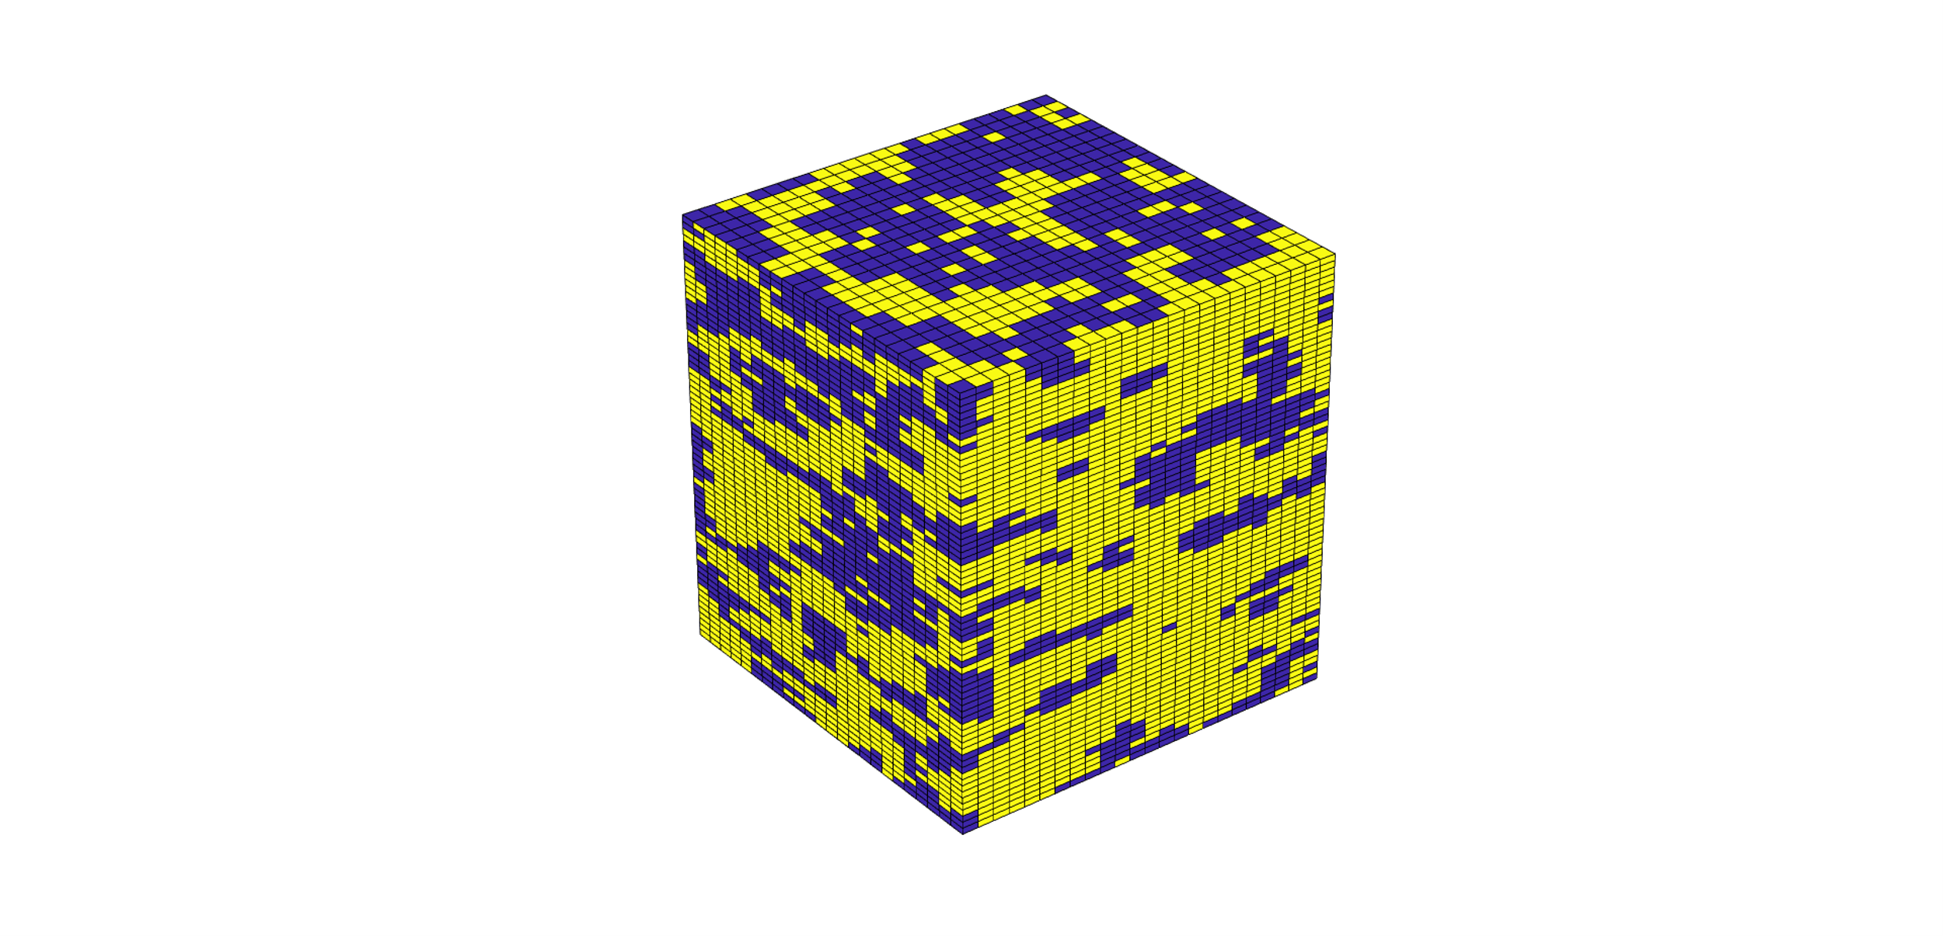

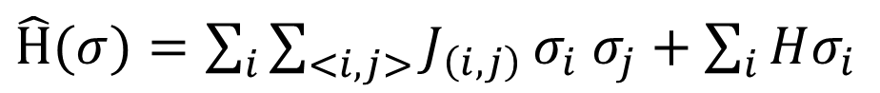
Ising Model for FM materials
Ising model is a multi-domain model for ferromagnetic materials which consider each dipole in the FM to be an individual entity.
A 3D Ising model with circular boundary condition is used to simulate the toroid used in the work.
Applied external
magnetic field
Nearest neighbor spin interaction
Hamiltonian of the system
$\hat{Η}(σ)=\sum_{i}{\sum_{<i,j>}{J_{\left(i,j\right)}}}σ_{i}$ $σ_{j}+\sum_{i}{Hσ_{i}}$
Circular boundary condition

Slide 14
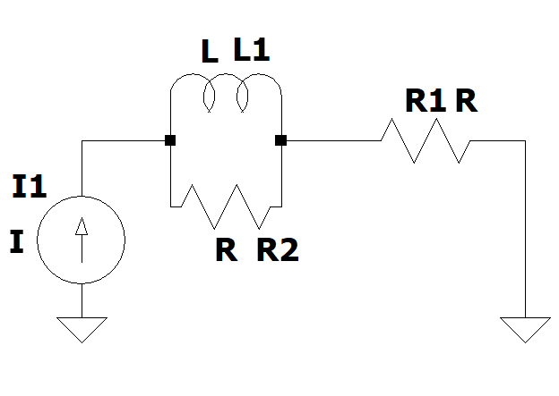
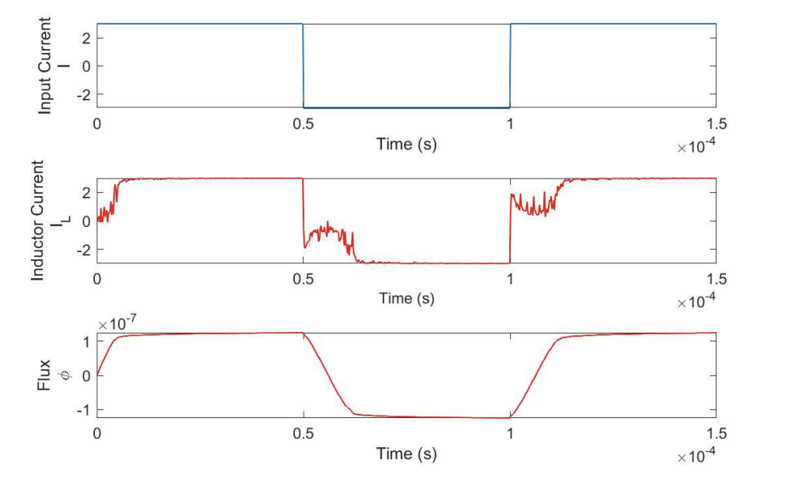
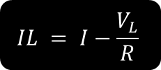
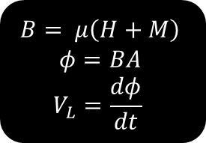
Ising Model Results which Shows NI
Simulation results..
Simulating circuit
Ising Model
(Monte-Carlo)
$$B= μ\left(H+M\right)$$
$$φ=BA$$
$$V_{L}=\frac{dφ}{dt}$$
IL- guess
$$IL = I−\frac{V_{L}}{R}$$
Stop at convergence

Slide 15
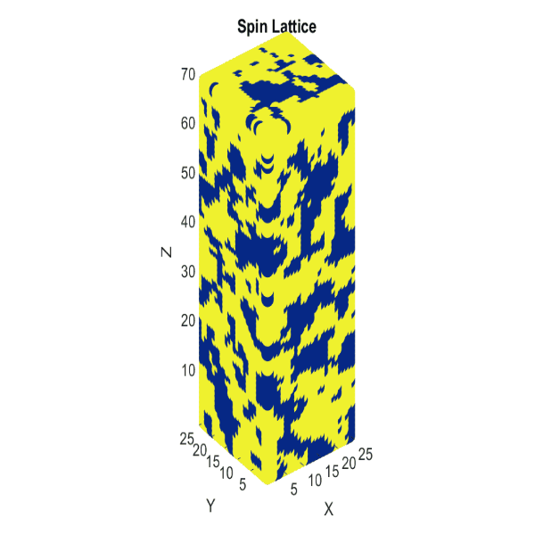
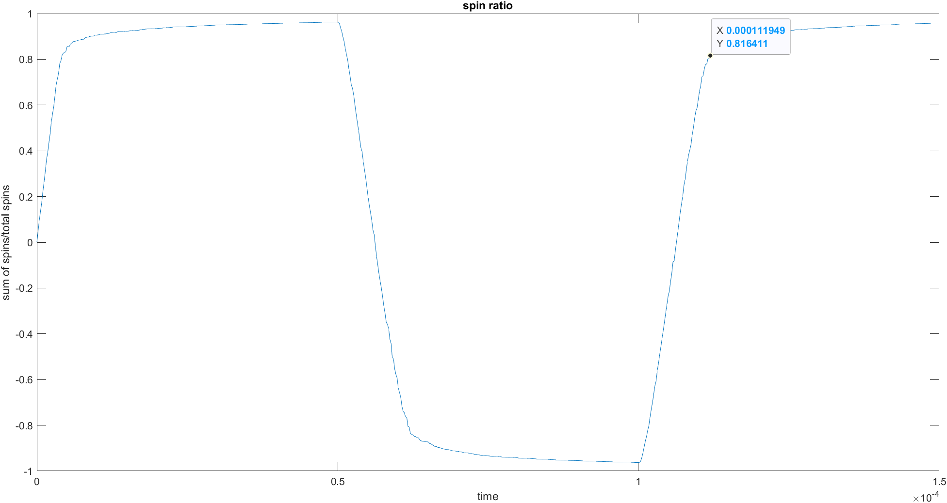
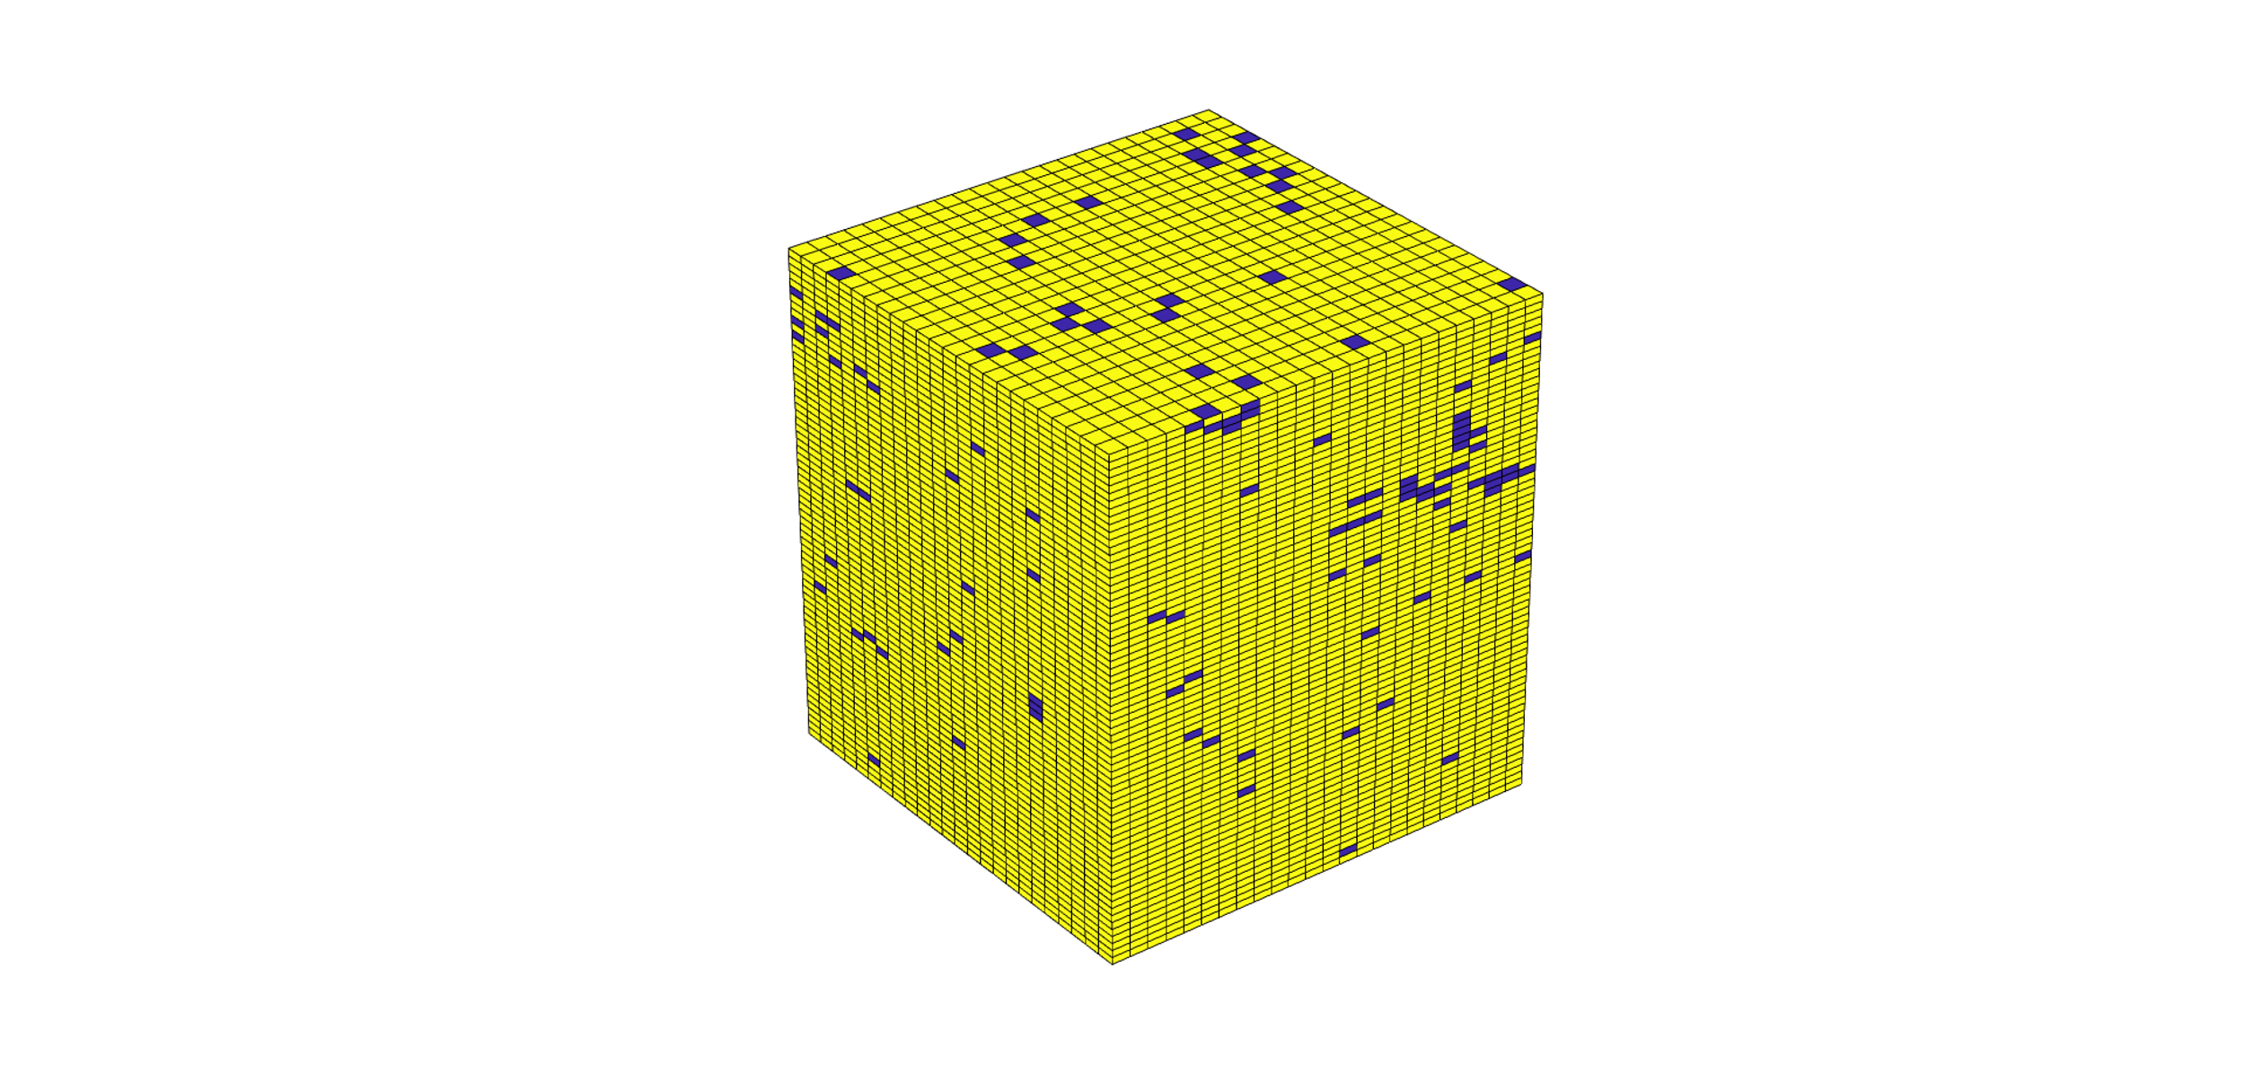
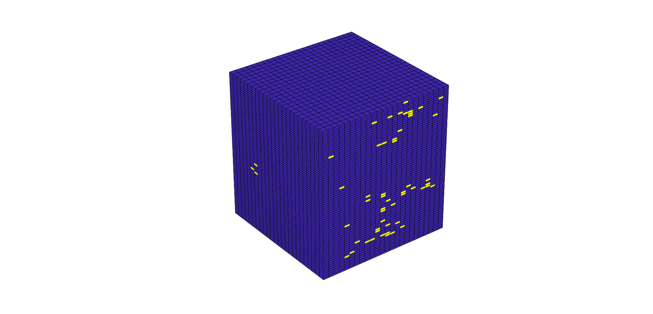
Switching Behaviour of the Ising Spin Structure
Simulation result from The Ising Model

Slide 16
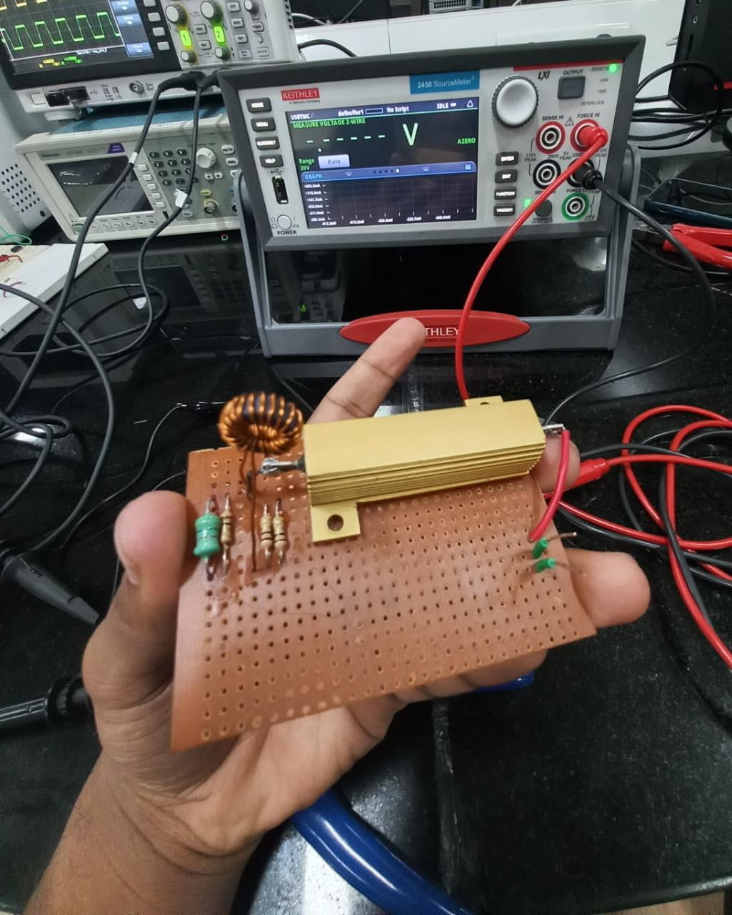
Experimental Results which Confirms NI
Experiment setup
3R-ferromagnetic core with 20 ( 40 ) windings
4 Ω power resistor
V1
V2
SMU
1 Ω resisters in parallel

Slide 17
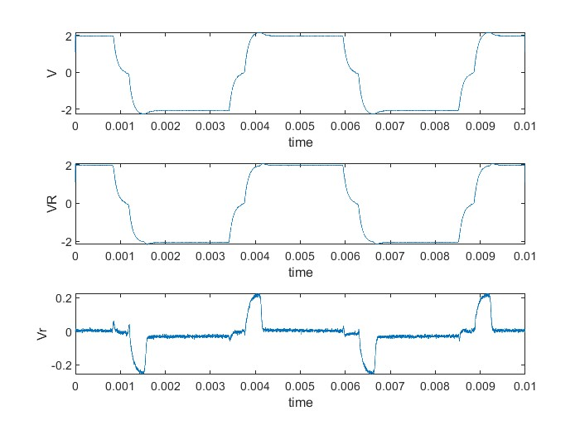
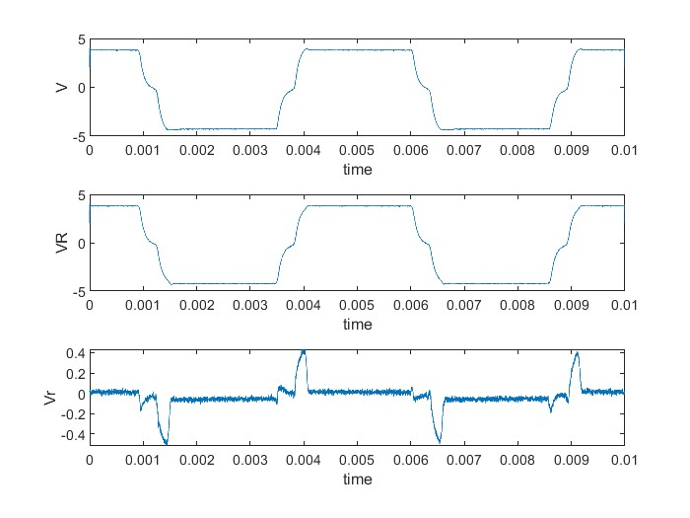
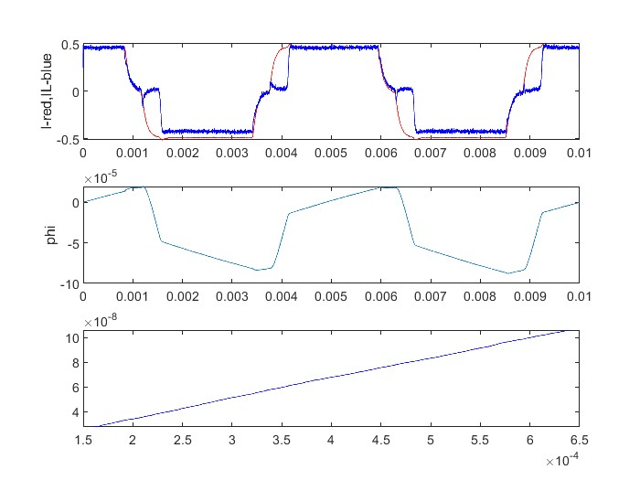
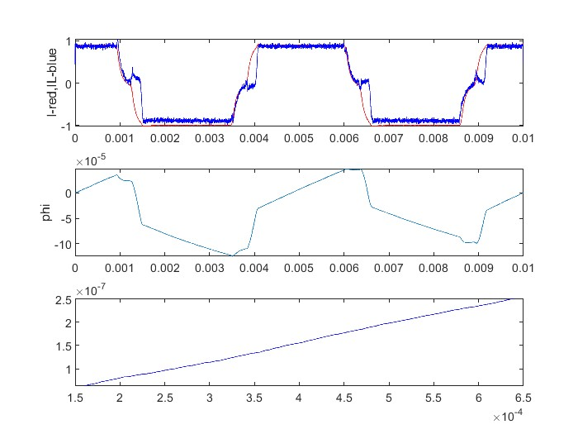
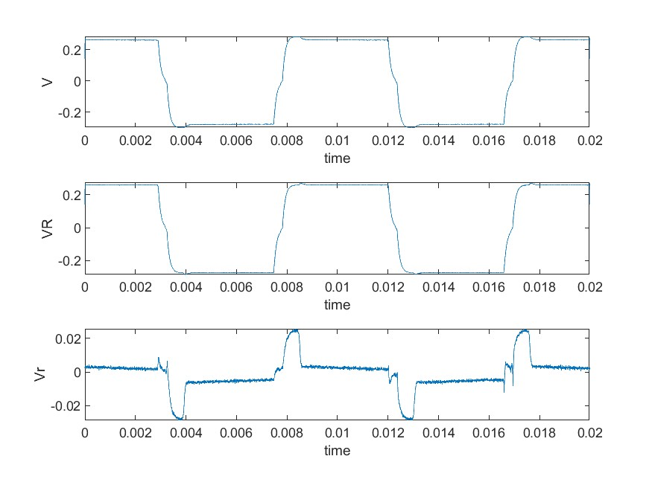
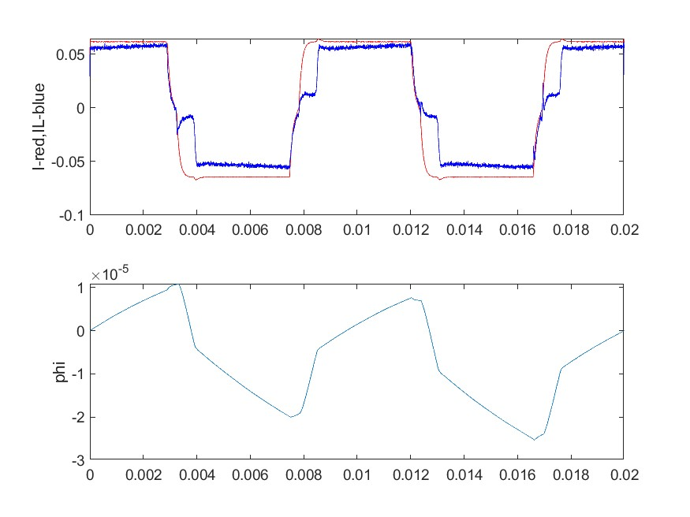
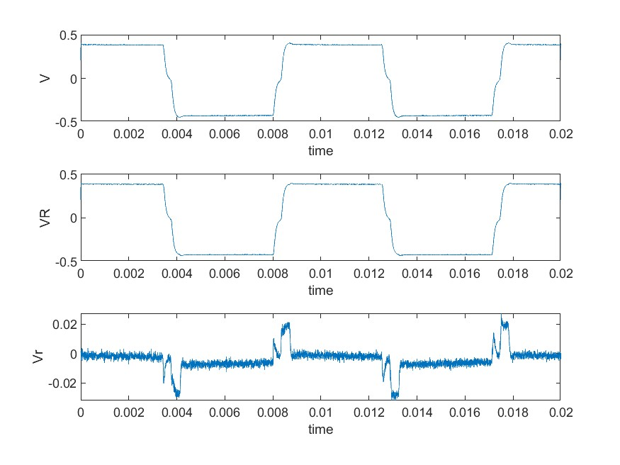
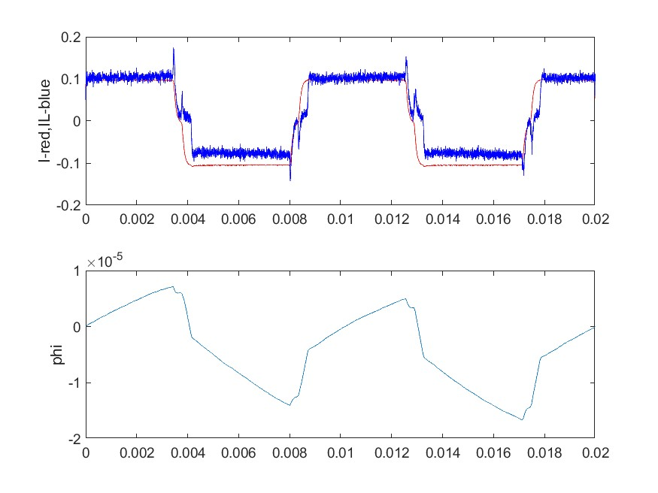
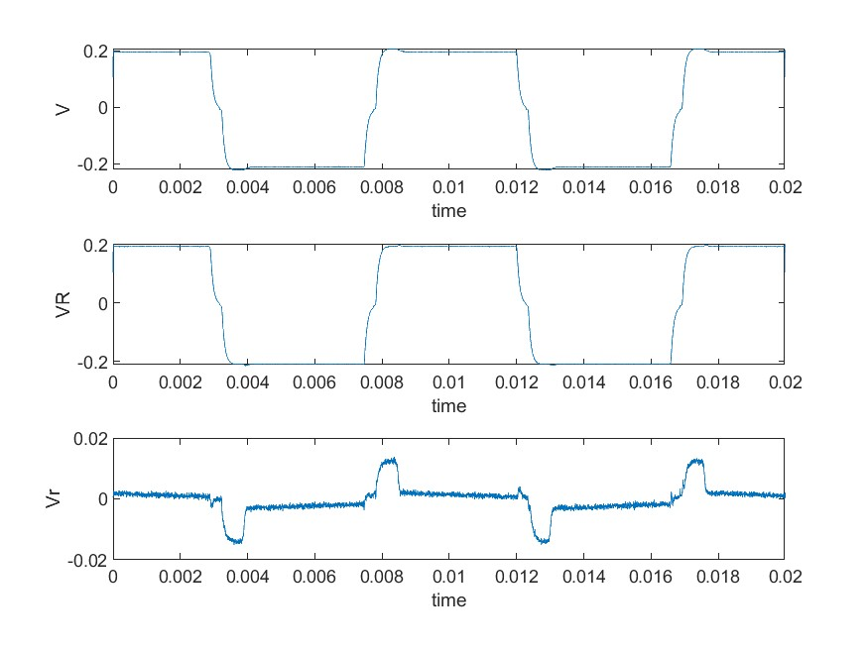
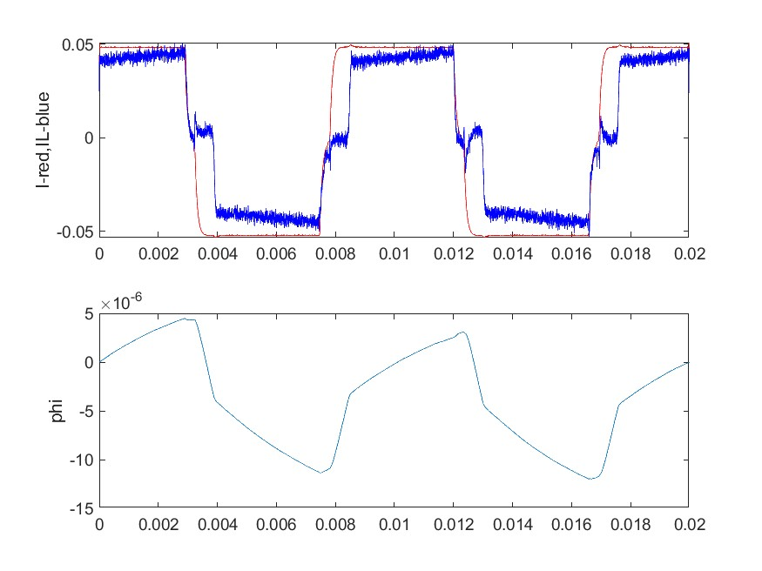
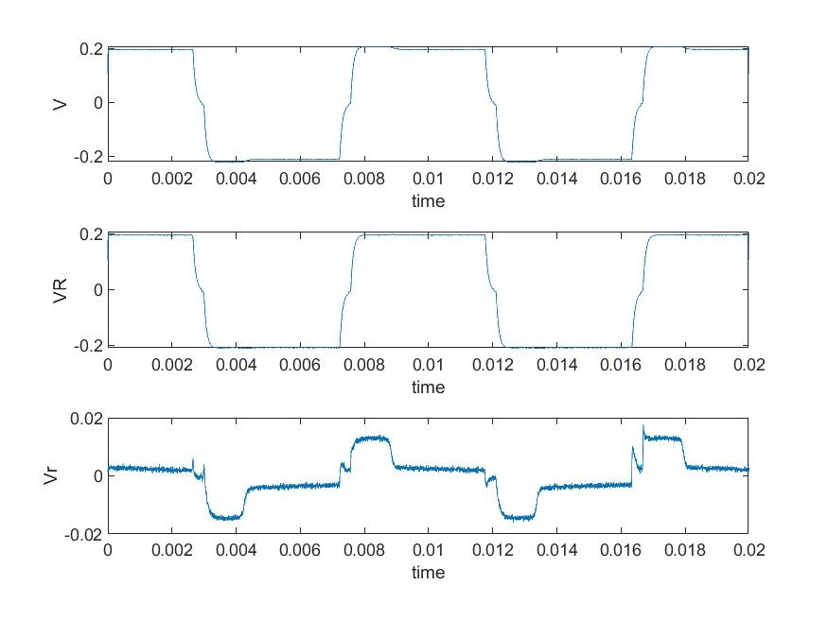
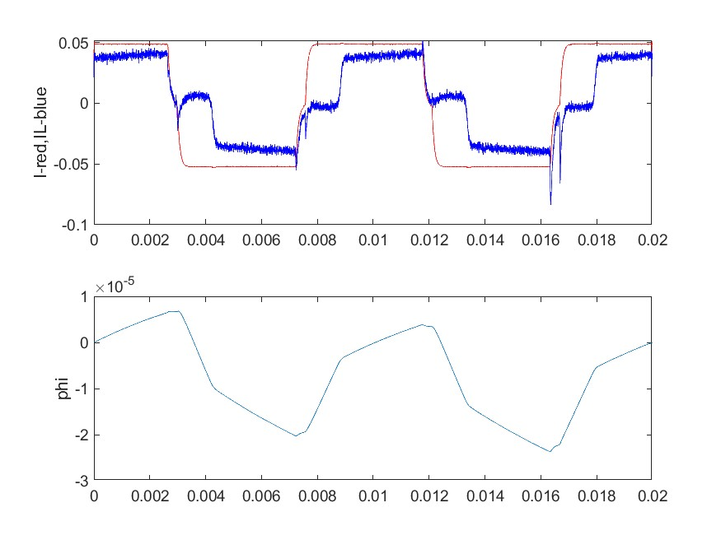
Experimental Results Which Confirms NI
I = 0.5 A, Rp = 0.5, t = 4e-3, N = 20
I = 1 A, Rp = 0.5, t = 4e-3, N = 20
Measurements with SMU
A variety of parameters such as the Parallel resistance, Number of turns and Current Amplitude were varied. Measurement are taken using Keysight DSO_x1102G.
I = 0.5 A, Rp = 0.5, t = 4e-3, N = 40
I = 1 A, Rp = 0.25, t = 4e-3, N = 20
I = 0.5 A, Rp = 0.25, t = 4e-3, N = 20
I = 0.5 A, Rp = 0.25, t = 4e-3, N = 40

Slide 18
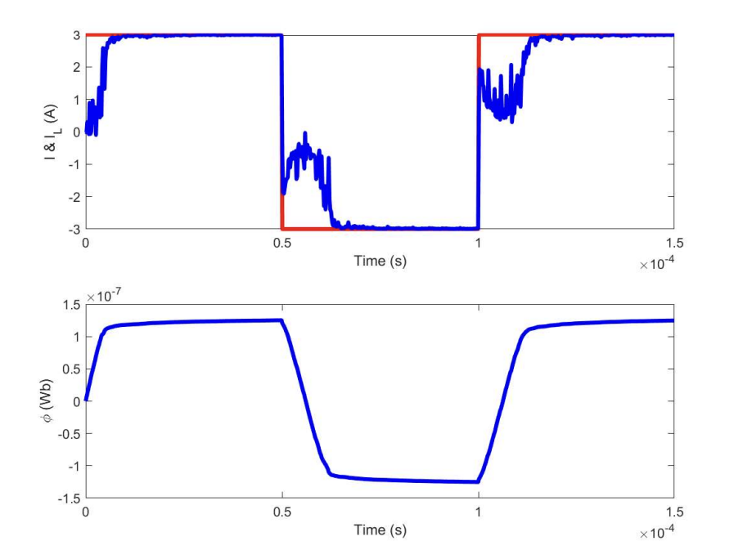
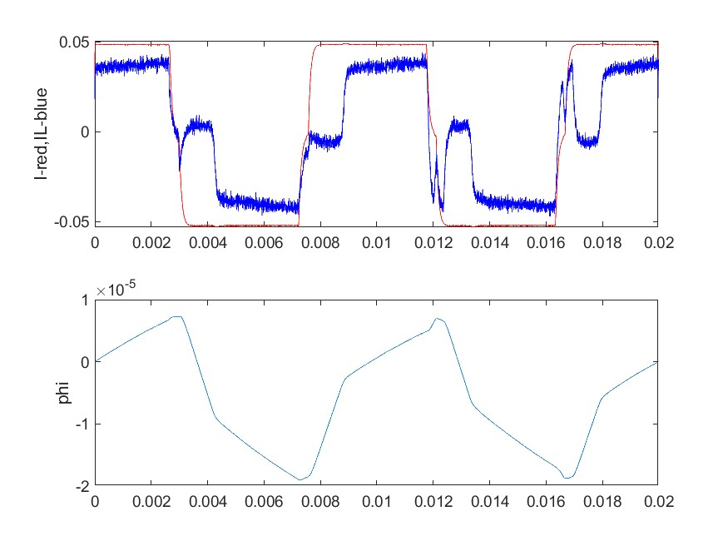
Comparison with Simulation Results
Ising Model
SMU measurement

Slide 19

Comparison with NC Results
Our SMU results & Asif Khan’s paper (NC)
FM - Inductor response in input square current waveform
FE Capacitor response in square Voltage waveform

Slide 20
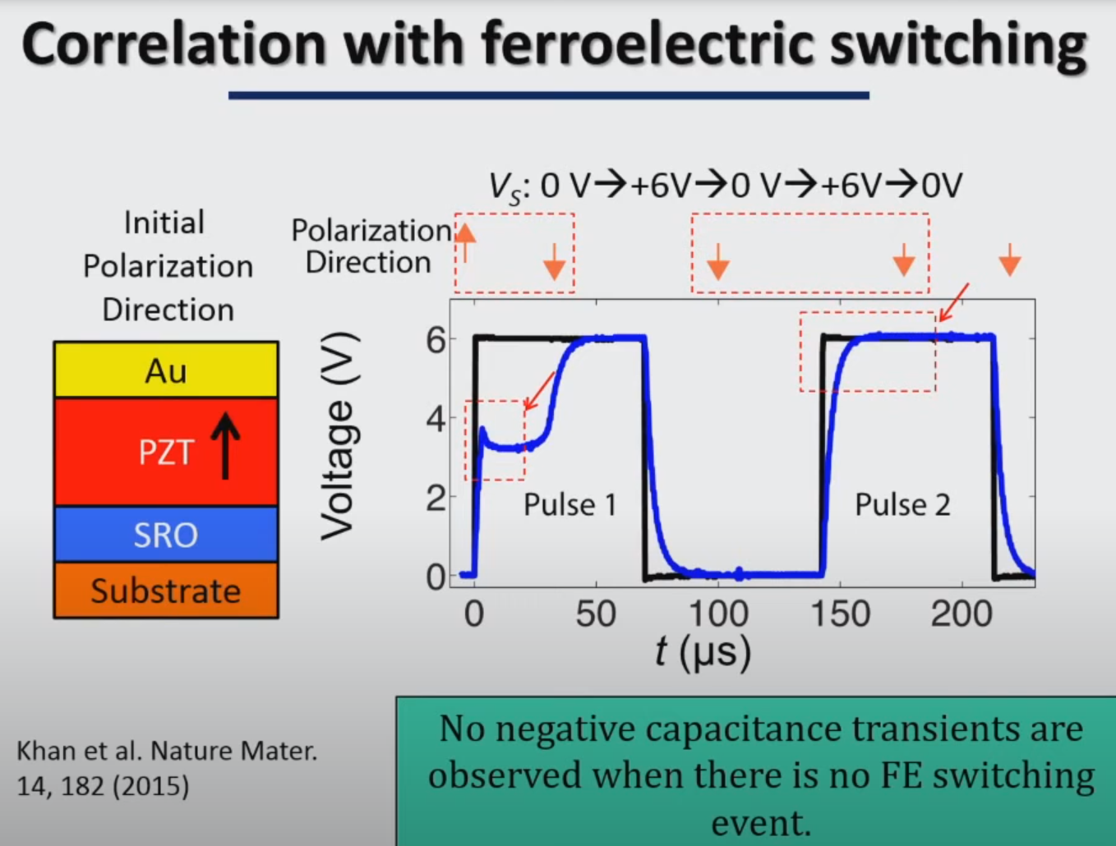
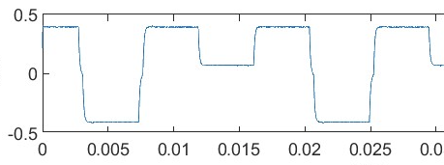
Comparison with NC Results
We tried one switching and non switching pulse..
Trying to apply the similar check done by the NC experiment
Source link: https://www.youtube.com/watch?v=jIaxc1RfNM0&t=538s

Slide 21

Comparison with NC Results
Switching
No Switching

Slide 22

Benchmarking the Results with the Experiment Data
Tuning the Ising model hysteresis to the inductor hysteresis
Experimentally verified hysteresis loop
Tuned the model parameters to match
the core’s hysteresis loop

Slide 23

Benchmarking the Results with the Experiment Data
Now used the updated model to run the Ising simulation

Slide 24


More Robust Setup to Clean Up the Results
Voltage controlled Current Source - a design from TI
Simulation and verification of the design
are done on Tina-Cloud simulator
(circuit simulator of Texas)
Schematic designed in KiCAD

Slide 25




Tested in Breadboard
Voltage controlled Current Source - a design from TI
Ground
+V (5V)
I_{out} (floating)
V_{func} (2.5 offset)
V_{ref} (2.5V)
Ground

Slide 26


VCCS PCB
PCB design and the printed board
Layout in KiCAD
PCB ordered from Lionscircuit
Notes:
The PCB is not populated yet

Slide 27
Modification in the current source for SR measurement & Future Plans
PCB population and testing
Measure S – Curve that characterise the NI
A additional input to add noise to the input
The characteristics of noise will vary at the output so the we need to find a way to get the desired noise induced current in the output
We will try to experimentally obtain SR with our setup, and then move to simulation for benchmarking

Slide 28
Thanks to …
Priyankka G. R.
S. Harivignesh
Madhav Ramesh
Rekha S. S.
Abhinav Rajeev
&
our faculty advisor
Dr. Arvind Ajoy
For helping us in this project

